Slide 1

Ethereum: Time Series and Forecasting
Final Project
Prince Sekyi

Slide 2
What is Ethereum

Slide 3
Decentralized blockchain that provides a verified and trusted environment for programs to run.
A cryptocurrency

Slide 4
Problem Statement and Goals

Slide 5
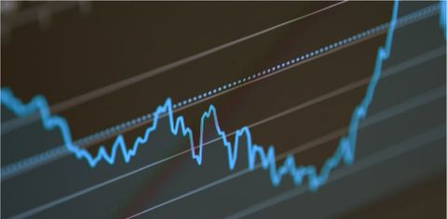
Problem Statement
Cryptocurrency is very risk hence is Ethereum. Knowledge of the price of Ethereum gives directions on investing or the measure of investing in this cryptocurrency.

Slide 6
Goals
observe the trends of the price of Ethereum over the years through Exploratory Data Analysis.
predict the price of Ethereum using various Time Series and Machine Learning algorithms.

Slide 7
Data Cleaning and Data Wrangling

Slide 8
Dataset
Historical dataset of the price of Ethereum (ETH) from March 10th 2016 to August 9th 2021 . It has the following variables
Date: Date of the ETH prices
Price: Prices of ETH (dollars)
Open: Opening price of ETH on the respective date (Dollars)
High: Highest price of ETH on the respective date (Dollars)
Low: Lowest price of ETH on the respective date (Dollars)
Vol.: Volume of ETH on the respective date (Dollars).
Change %: Percentage of Change in ETH prices on the respective

Slide 9

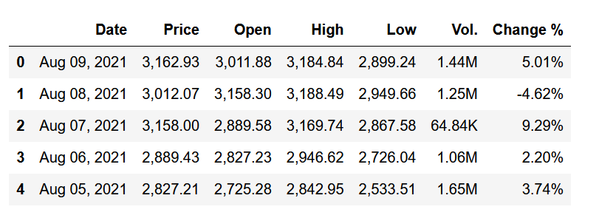
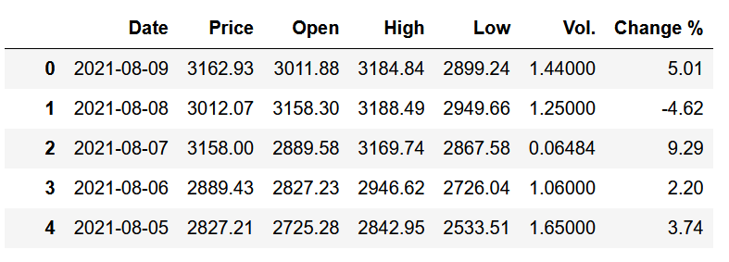
Data Wrangling
Below shows the transformation of the original dataset obtained
Date variable changed to time
Commas in Price, Open, Low, High variable removed
Volume variable change to real amount
Missing and undesired variables removed

Slide 10
Exploratory Data Analysis (EDA)

Slide 11
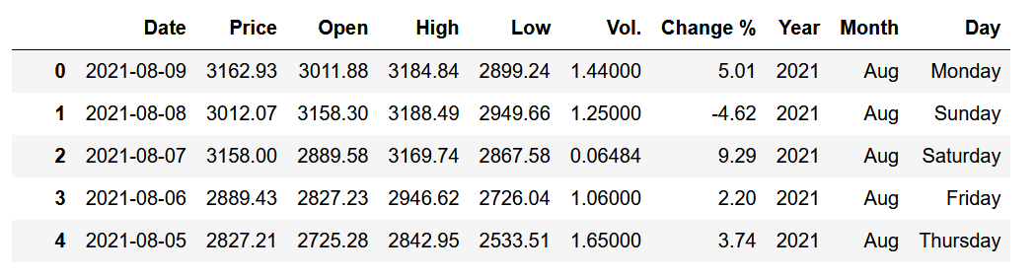
New variables (Year, Days and Months) where created for exploratory data analysis (EDA). The final data frame for EDA is below.

Slide 12
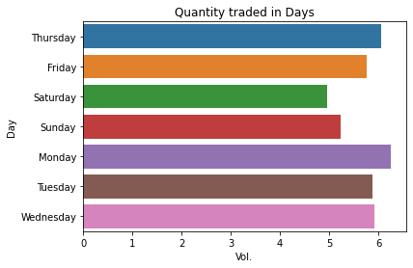
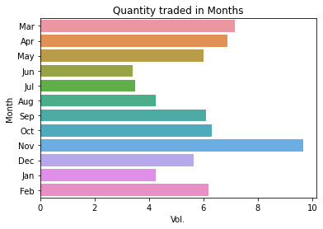
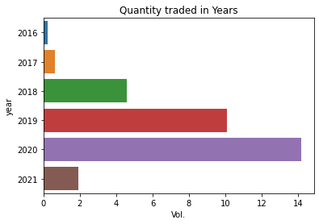
Checking Volume Traded with time

Slide 13
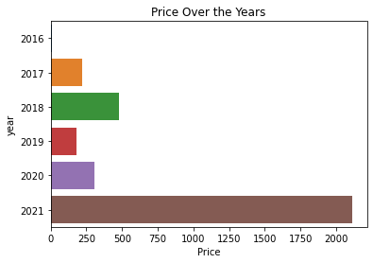
Price compared with years

Slide 14
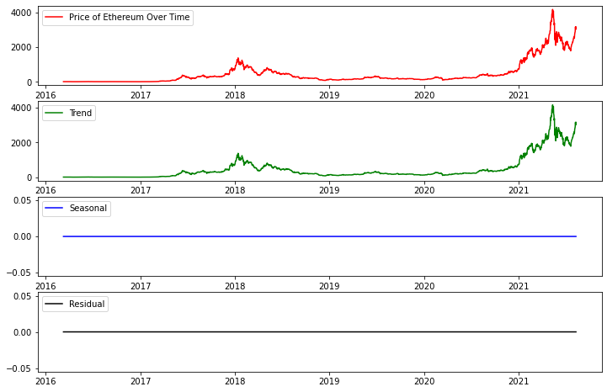
Seasonality and Trend Check

Slide 15
Model, Forecasting, Recommendation

Slide 16
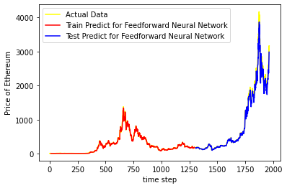
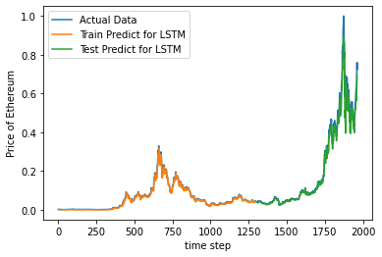
Model
Deep Learning algorithm, Feedforward Neural Network and Long short-term memory were used to fit the model. The graphs below were obtained
Train Score: 22.45 RMSE,
Test Score: 118.38 RMSE
Train Score: 0.01 RMSE,
Test Score: 0.04 RMSE

Slide 17
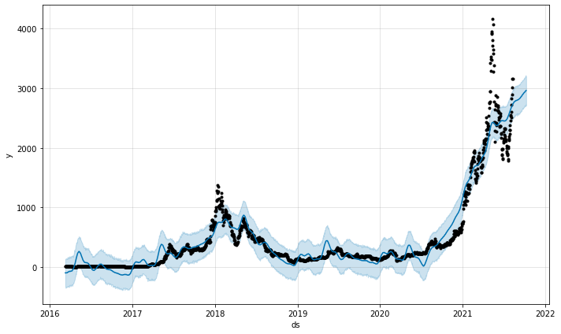
Forecasting
Facebook Prophet was used as the forecasting tool for this project.
Time variable was changed to ds and Price was change y.

Slide 18
Statistical Summary
Statistics | Value
count | 114.00
mean | 3141.10
std | 208.49
min | 2826.66
25% | 2959.90
50% | 3112.47
75% | 3305.63
max | 3600.77

Slide 19
Recommendation
Below are recommendations for further study
I will consider using more and most current data of the historical price of Ethereum
will consider other Machine Learning time series algorithm
I will also use other ways to evaluate Deep learning models

Slide 20
End Thank You Very Much

